Slide 1
Consider stability from a different perspective.
Lyapunov stability we examined the evolutions of the state variables
Space of all inputs
Space of all outputs
Mapping
Now consider a “black-box” approach where we look at the relationship between the input and the output

Slide 2
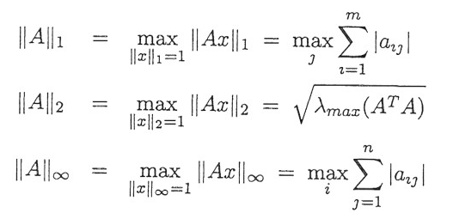
q=size of u(t)
u(t)
If true, makes a statement on the whole of u over all time
This is different than the vector and matrix norms seen previously (chapter 2):
Vector norms
Matrix norms

Slide 3
This function norm actually includes the vector norm:
Goes beyond the Euclidean norm by including all time
If true, means no elements “blow up”

Slide 4
Point at T:
T
time

Slide 5
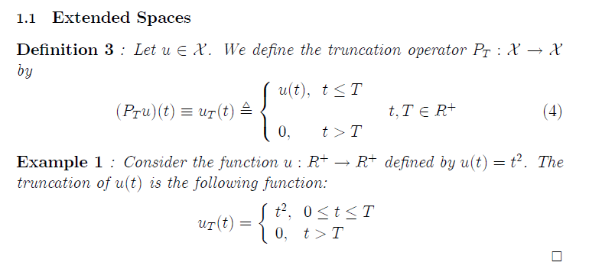
A function space

Slide 6
Extended function space
A function may not necessarily belong in the original function space but may belong to the extended space.
Truncation
All
functions

Slide 8
A differential equation is just a mapping
In simple terms: The light doesn’t come on until the switch is switched on.

Slide 9
Example of a causal system
Find normal output then truncate output
Truncate input, find normal, output then truncate output
This part of the input doesn’t affect the output before time T
H operates on u
If Causal
Notes:
Green box removes the t

Slide 10
Hu

Slide 11
Bounding the operator by a line -> nonlinearities must be soft
Systems with finite gain are said to be finite-gain-stable.

Slide 13
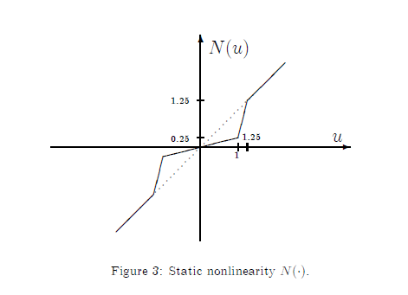
Static operator, i.e. no derivatives
(not a very interesting problem from a control perspective)
Slope = 1
Slope = 4
Hu=.25+.4=.625
Slope = 0.25
u=1.1
Hu/u=.6
Looking for bound on ratio of input to output not max slope

Slide 14
What about this?
Slope = 0.25
Look for this max slope:
Slope = 4
Slope = 1
=4

Slide 15
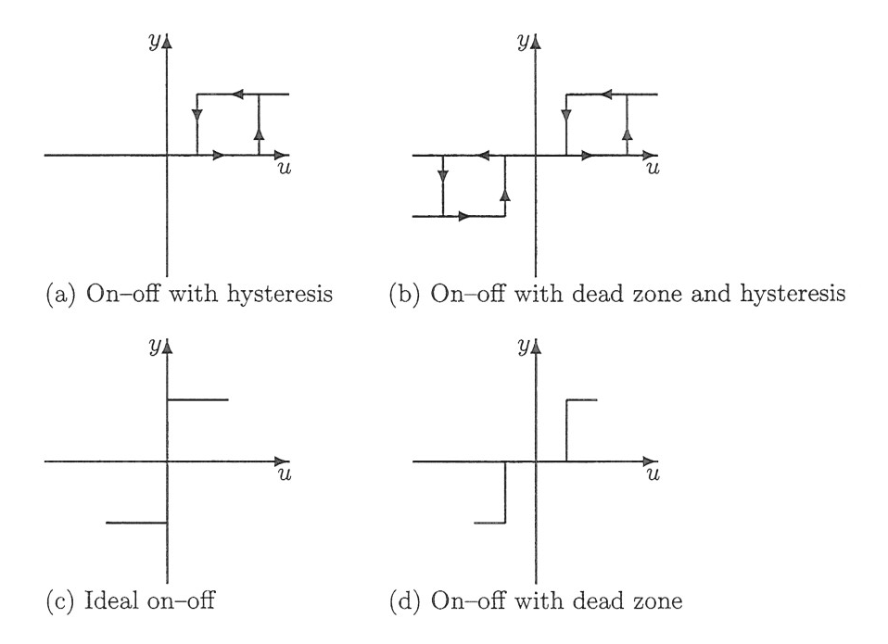
Example:
Hu

Slide 16
Example (cont):

Slide 17
Example (cont):

Slide 18
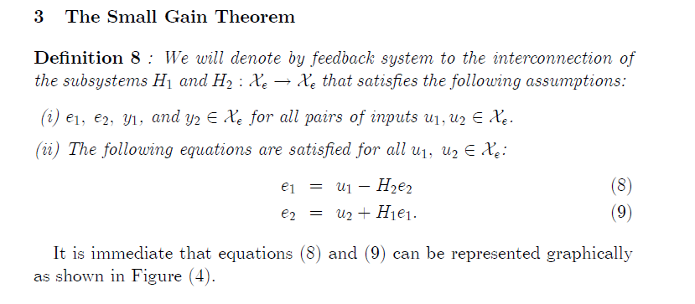
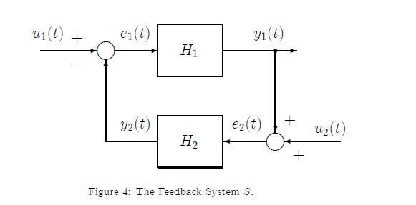

Slide 19
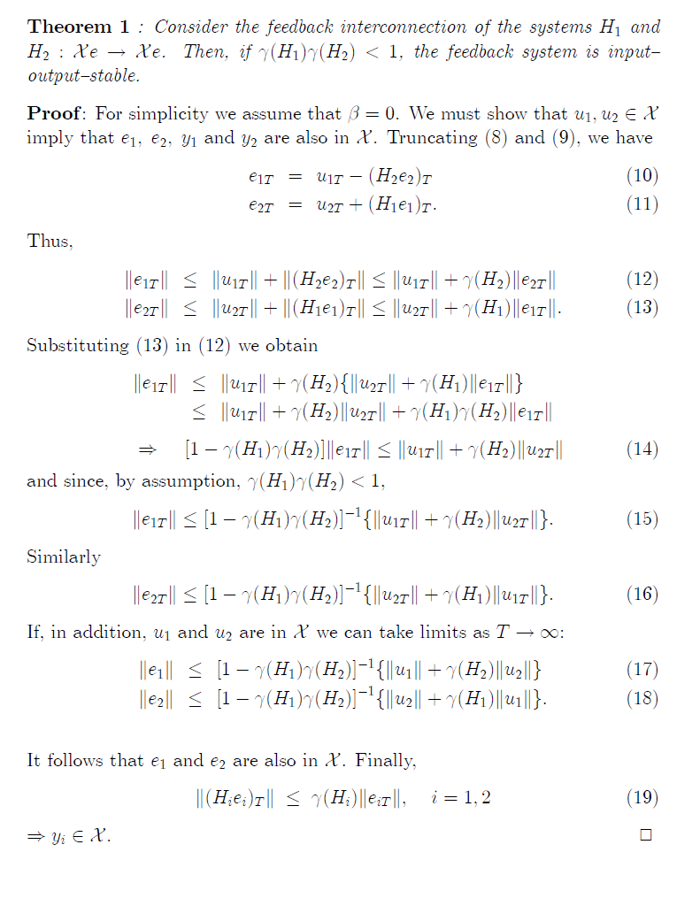

Slide 21
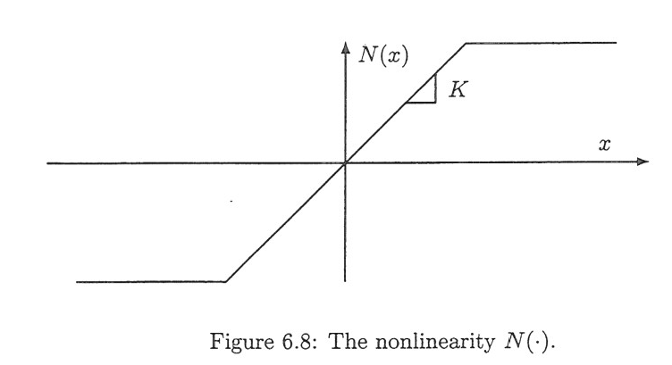
Examine stability of the system using the small-gain theorem

Slide 22
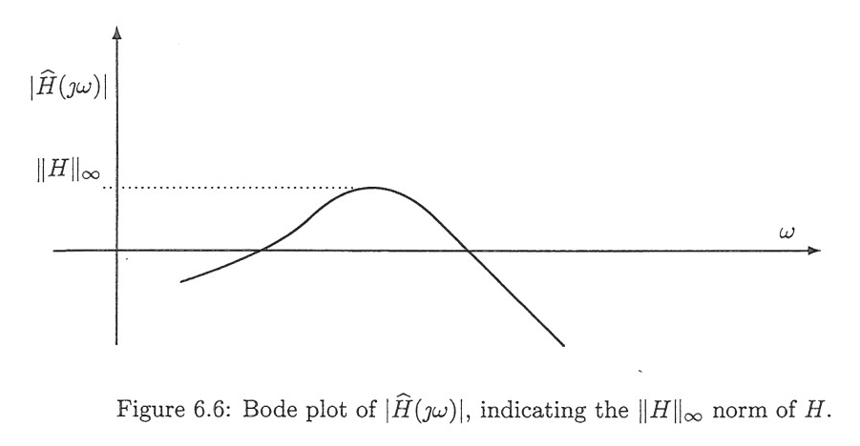
In general, need to find the peak in the Bode plot to find the maximum gain:

Slide 23
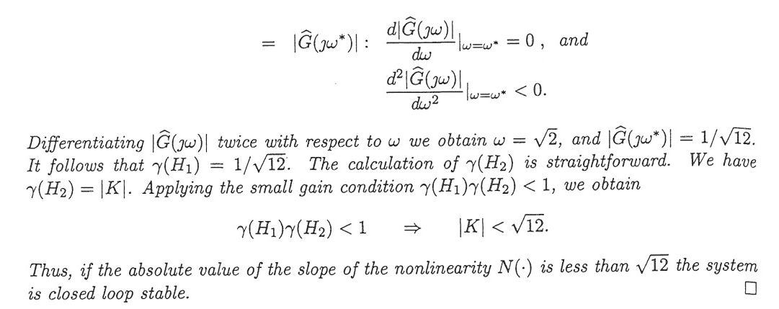

Slide 24
Maximum gain of the nonlinearity:

Slide 26
Summary
Tools:
Function Spaces
Truncations -> Extended Function Spaces
Define a system as a mapping
- Causal
Describe spaces of system inputs and outputs
Define input output stability based on membership in these sets
Small Gain Theorem
Specific conditions for stability of a closed-loop system

Slide 27
Homework 6.1

Slide 28
Homework 6.2
Examine stability of the system using the small-gain theorem
K

Slide 29
Homework 6.2
Examine stability of the system using the small-gain theorem
K

Slide 30
Homework 6.2
Examine stability of the system using the small-gain theorem
K

